Slide 1




Pareto Comparison Plots

Slide 2
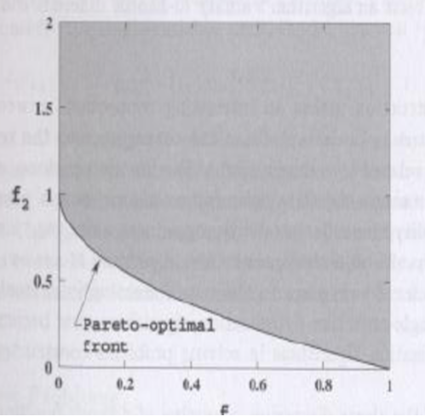
ZDT1
GOAL
Achieved

Slide 3
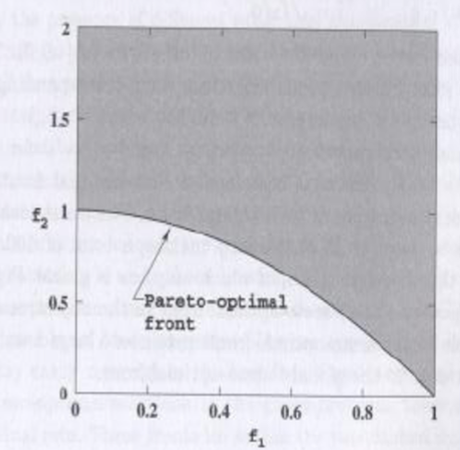
ZDT2
GOAL
Achieved

Slide 4
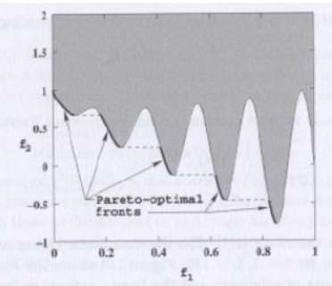
ZDT3
GOAL
Achieved

Slide 5
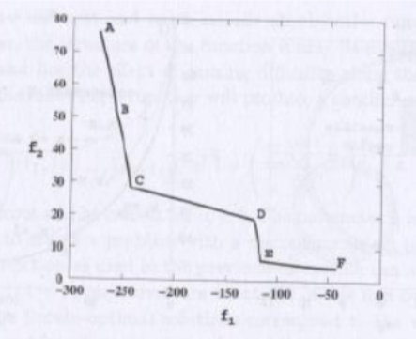
OSY
GOAL
Achieved

Slide 6
CTP
GOAL
Achieved

Slide 7
TNK
GOAL
Achieved

